Slide 1
Justice Community Innovation Network (JCOIN): A system level implementation intervention to improve justice-health service linkage
Jennifer Becan, Ph.D.
Research Scientist
Texas Christian University
Illinois Certification Board
March 21, 2023

Slide 2
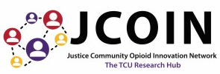
Much of the work described herein was conducted by the following collaborative teams:
Acknowledgement
The National Institute on Drug Abuse, National Institutes of Health (NIDA/NIH), through a grant to Texas Christian University (DA050074; MPI Kevin Knight, Danica Knight, David Olson, Noah Painter Davis), provided funding for this study.
Interpretations and conclusions from this presentation are entirely those of the authors and do not necessarily reflect the position of NIDA/NIH or the NIH HEAL Initiative.

Slide 3
JCOIN TCU Hub Investigators
Texas Christian University
Kevin Knight, Principal Investigator
Danica Knight, Principal Investigator
Pam Carey, Justice Partner
Jenny Becan, Project Director
Jenni Lux, Implementation Lead
Amanda Wiese, Data Lead
Chelsea Wood, Project Coordinator
Brandi Stein, Qualitative Coordinator
Ashley Gainey, Public Health Research Associate
Francesca Gentea, Graduate Research Assistant
Brooke Preston, Research Assistant
Heather Hines, Research Assistant
Rene Hinojosa, TDCJ
Andrea Canul, TDCJ
Illinois Partners
David Olson, LUC Principal Investigator
Dona Howell, Justice Partner
Jac Charlier, TASC Executive Director
Jon Ross, TASC Director Research and Evaluation
Cierra McDonald, TASC
Sophia Juarez, TASC
Jason Garnett, IDOC
New Mexico Partners
Noah Painter Davis, UNM Principal Investigator
Roberta Chavez, UNM, CASAA
Amber Martinez, UNM, CASAA
Rose Armijo, UNM CASAA
Rena Quintana, UNM CASAA
Neil Greene, Post-Doctorate Assistant
Linda Freeman, Sentencing Commission

Slide 4
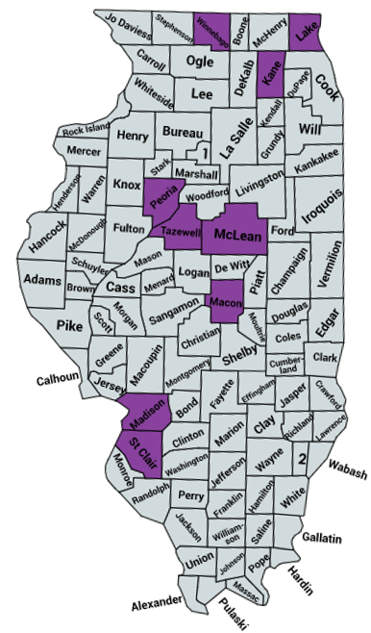
JCOIN TCU Hub Communities: Illinois
Winnebago
Lake
Kane
Peoria/Tazewell
McLean/Macon
Madison/St Clair
Yellow = Correctional Facilities

Slide 5
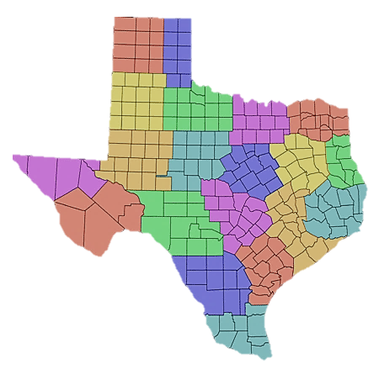
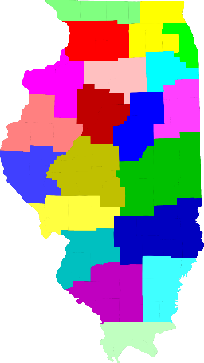
Project Goal: Increase access to and retention in substance use and medications for opioid use disorder (MOUD) treatment among adults with a history of, or at risk for, using opioids (or other substances) who are placed on parole, mandatory supervised release, after a period of incarceration.
By the Numbers
2.5 years of interagency collaborative coaching and networking
18 communities (18+ Parole Offices, 36+ Health Service Organizations)
200+ Parole and Service Agency Stakeholders
20+ Investigators from 6 Universities and State Organizations (Justice Systems, Sentencing Commissions, Case Management Agencies)
Texas
Illinois
New Mexico
18 communities
(Knight, Becan… Knight, 2021, JSAT)

Slide 6
Criminal Justice and Substance Use
60% of individuals incarcerated in local jails report issues with substance use. Estimates are similar for individuals in state run criminal justice facilities.
During a 10 year study, 58% of justice-involved individuals released after serving time for drug related offenses were re-arrested on drug related offenses.
(Bronson et al., 2021)
(Antenangeli & Durose, 2021)

Slide 7
Community Reentry Substance Use Services Cascade for Individuals Recently Released to Community Supervision
Targeted community development
Clinical
Substance Use
Treatment
Prison
Transition Planning
Referral & Linkage
Referral & Linkage
Community
Supervision
Screening Assessment
Screening
Assessment
Treatment
Medications for Substance Use Treatment
Criminal Justice
Substance Use Treatment Providers
Delivery Setting
Adapted for JCOIN TCU Hub:
From JJ-TRIALS Behavioral Health Services Cascade
Belenko, Knight et al., 2017, JSAT

Slide 8
Benefits of Research Practice Partnerships
Help facilitate/broker cross-agency collaborations
Can better identify and address barriers
Can help speed science to practice
PPO supervisor
Medication for Opioid Use Disorder Agency Rep
Clinical supervisor
PPO Staff
Substance Use Agency Rep

Slide 9
Implementation Science Framework
EPIS conceptualized for JJ-TRIALS as a Recursive, Cyclical Process
Outer System Context
Inner Context
EPIS as a Linear Process
Exploration Phase
SUSTAIN
EXPLORE
Advocacy
Preparation Phase
Patient
Centered
Collaboration – Negotiation
– Coalescence
Service Systems
Research
Problem-Solving
Orientation
Implementation Phase
CBOs/Providers
IMPLEMENT
PREPARE
Sustainment Phase
(Becan, Bartkowski, … Aarons, 2018, Health and Justice)

Slide 10
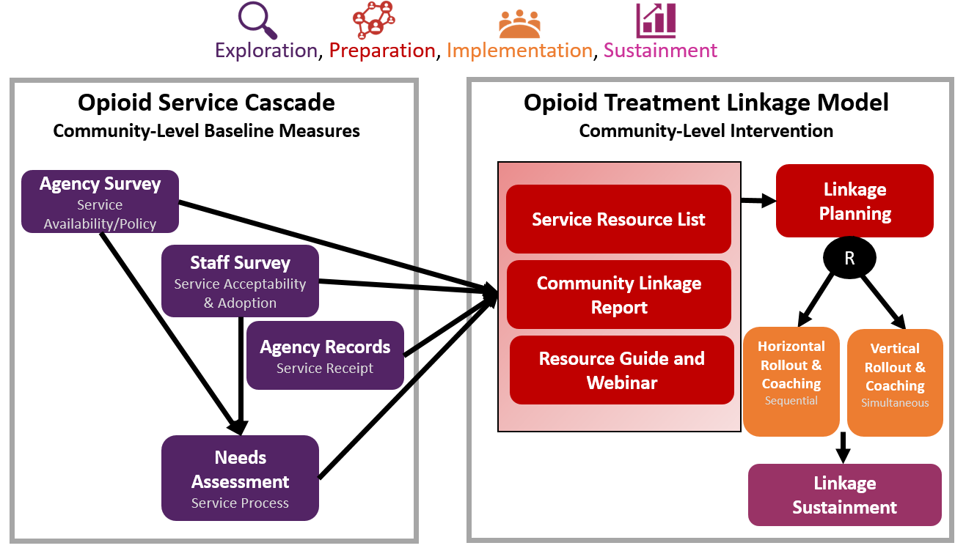
2.5 Years of Interagency Community-Wide Collaborative Intervention

Slide 11
Clinical Intervention: Opioid Treatment Linkage Model (O-TLM)
Resource Guide and Webinar
Resource on best and innovative practices along a cascade of services for justice-health communities
Informed by research studies, community initiatives, and state/federal-level programming (HEALing Communities Study ORCCA, SAMHSA TIPS, JCOIN cooperative…)
Provides a universal set of service indicators from several performance measures (ASAM, NCCHC, …)

Slide 12
JCOIN TCU Hub Research Interests
Regardless of system change approach
Examine access to (referral rate increase) and retention in (appointments kept) SU and OUD services
Examine outcomes associated with public health (days and amount of illicit drug use, including opioids) and public safety (e.g., re-arrest rates)
Compare system change approach on
Systems-level outcomes with respect to implementation (e.g., costs, attitudes of acceptability) and service outcomes (e.g., referral rates)
Uptake timing and sustained use of EBPs based on the Opioid Treatment Linkage Model (O-TLM)
Individual level outcomes (e.g., services linkage, initiation and receipt, opioid use, other substance use, overdose, death, re-arrest)

Slide 13
Justice involved programming at the state and national level: where we have been and where we are going
David E. Olson
Loyola University Chicago
Center for Criminal Justice
Presented at the Illinois Certification Board Spring 2023 Conference

Slide 14
Where we have been & where we are going
The 1980s through the 1990s
The 1st “real” war on drugs and rising crime
The two waves: crack cocaine & methamphetamine
Earned Discretionary Sentence Credit
From “Evening Narcotics Court “ to Drug Treatment Courts
The early 2000s
Trying to bring treatment to scale
The third wave: opiates
Incorporation of the risk, needs & responsivity model
A shift in the sentencing mindset
2020 and beyond
Smaller, leaner, and smarter
Pretrial reform & its implications for treatment access

Slide 15
Violent Crime, Arrests for Drug-Law Violations, and Sentencing Patterns

Slide 16
Drug Arrests in U.S.: Police Respond
Source: Federal Bureau of Investigation, Crime in the U.S.

Slide 17
2005: Arrests for non-cannabis drug-law violations vs. past-year use
2019: Arrests for non-cannabis drug-law violations vs. past year use
Source: Analyses by Loyola’s Center for Criminal Justice of Federal Bureau of Investigation (Crime in the U.S.) &
Substance Abuse and Mental Health Services Administration data (National Survey on Drug Use and Health)
Notes:
https://www.dpft.org/resources/NSDUHresults2005.pdf

Slide 18
Arrests for Drug-Law Violations in Illinois(*800+)
Source: Analyses by Loyola’s Center for Criminal Justice of Illinois
Uniform Crime Report data, provided by Illinois Criminal Justice Information Authority

Slide 19
Violent & Property Index Offenses in Illinois(*800+)
Source: Analyses by Loyola’s Center for Criminal Justice of Illinois
Uniform Crime Report data, provided by Illinois Criminal Justice Information Authority

Slide 20
Felony Case Filings in Illinois Courts (*102)
Down 28%
More than
doubled
Source: Analyses by Loyola’s Center for Criminal Justice of data published
by the Administrative Office of the Illinois Courts (AOIC)

Slide 21
Percent of Convicted Felons Sentenced to Prison vs Probation in Illinois (*102)
10% of 57,675=5,767
more sentences to prison
12% of 46,661=5,599
fewer sentences to prison
Source: Analyses by Loyola’s Center for Criminal Justice of AOIC annual court statistics with adjustments made to address reporting issues.

Slide 22
Adults Under the Custody of the Criminal Justice System

Slide 23
Total Adults Convicted of a Felony Under Correctional Supervision in Illinois
26% decrease
100% increase
Source: Analyses by Loyola’s Center for Criminal Justice of IDOC and Administrative Office of the Illinois Courts data;
felony probation cases estimated
Notes:
.

Slide 24
Trends in Felony Correctional Populations in Illinois
2015 to 2021
-17%
-42%
-20%
Source: Analyses by Loyola’s Center for Criminal Justice of IDOC and Administrative Office of the Illinois Courts data;
felony probation cases estimated

Slide 25
97,000 Illinois Adults Under Supervision of Justice System for a Felony, Statewide 2021
Source: Analyses by Loyola’s Center for Criminal Justice of data
provided by the Illinois Department of Corrections’ Planning and Research Unit & AOIC published reports

Slide 26
Illinois Adult Prison Population
Source: U.S. Department of Justice Historical Statistics on Prisoners in State and
Federal Institutions, 1925-1986 and published IDOC data

Slide 27
The Dynamics of Prison Admissions, Length of Stay and Prison Populations
Iron Law of Incarceration: Correctional populations are determined by admissions and length of stay
The paradox of admissions to prison for “low level” offenses, risks and needs
Are most admissions to prison for drug law violations? Are most people in prison there for drug-law violations?
Length of stay will determine access to services

Slide 28
Composition of Annual Court Admissions to Illinois’ Prisons
1999 (N=24,347)
2014 (N=23,105)
2022 (N=13,865)
Source: Analyses by Loyola’s Center for Criminal Justice of data
provided by the Illinois Department of Corrections’ Planning and Research Unit

Slide 29
Composition of End-of-Year Illinois Prison Population
1999 (N=44,355)
2014 (N=48,921)
2022 (N=29,364)
Source: Analyses by Loyola’s Center for Criminal Justice of data
provided by the Illinois Department of Corrections’ Planning and Research Unit

Slide 30
Percent of Those Exiting Prison Identified as Need of Substance Abuse Treatment at Prison Admission
Figure to be included
Source: Analyses by Loyola’s Center for Criminal Justice of data
provided by the Illinois Department of Corrections’ Planning and Research Unit

Slide 31
Exits from Illinois’ Prisons onto Mandatory Supervised Release (MSR) and the MSR Population
Source: Analyses by Loyola’s Center for Criminal Justice Research, Policy and Practice of
data provided by the Illinois Department of Corrections’ Planning and Research Unit

Slide 32
Illinois Prison Recidivism Rate: Return to Prison within 3 years
Source: Illinois Department of Corrections Planning and Research Unit

Slide 33
3-Year Post-Release Rearrest Rates Among Statewide IDOC Exits
61% arrested for something,
most often a non-violent offense
Source: Analyses by Loyola’s Center for Criminal Justice of data provided by the Illinois Department
of Corrections’ Planning and Research Unit and CHRI data generated and provided by the Research and Analysis
Unit, Illinois Criminal Justice Information Authority

Slide 34
Long-Term Recidivism of Sheridan Correctional Center Participants vs. Comparison Group, 8-Years Post Release (2014)
Source: David E. Olson & Arthur J. Lurigio (2014) The Long-Term Effects of Prison-Based
Drug Treatment and Aftercare Services on Recidivism, Journal of Offender Rehabilitation, 53:8, 600-619

Slide 35
Impact of COVID-19 on Post-Prison Treatment Access and Matriculation (Sheridan & SWICC Experiences)
COVID negatively impacted admission into outpatient treatment programs and residential placements
Of those admitted to OP/IOP, COVID had no impact on successful completion, but of those admitted to residential programs, COVID had an adverse effect on successful completion
Recidivism still higher for those not admitted to aftercare, but substantially lower post COVID vs. pre-COVID
Complexity of both changes in policing during COVID and changes in policies regarding technical violators returned to prison

Slide 36
The Evolution and Impact of Drug Treatment Courts (and Other Treatment Courts)

Slide 37
From innovation to expectation
Innovation in early 1990s—from expedited criminal case management to incorporation of therapeutic interventions
From “Drug Court” to “Problem Solving Courts”
By 2012, roughly 2,000 adult drug treatment courts across the United State; 68 in Illinois

Slide 38
2-Year Recidivism Rates, Prison Exits & Winnebago County Probation Admissions *
* Only those cases with 2 years elapsed since prison exit & probation admission, excluding decreased
Source: Analyses by Loyola’s Center for Criminal Justice of data provided by IDOC’s Planning and Research Unit and the Winnebago County Probation Department

Slide 39
Pretrial Reforms and Their Implications for Substance Abuse Treatment of Justice-Involved Populations

Slide 40
Number of Admissions to Jail and Number of Pretrial Admissions to Jail
Source: Analyses of data provided by the Illinois Department of Corrections’ Jail and Detention Standards Unit by
Loyola University Chicago’s Center for Criminal Justice
Notes:
.

Slide 41
Average Daily Jail Population and Average Daily Pretrial Jail Population
Source: Analyses of data provided by the Illinois Department of Corrections’ Jail and Detention Standards Unit by
Loyola University Chicago’s Center for Criminal Justice

Slide 42
Estimate of Pretrial Detention and Supervision Among Pending Felony Cases in Illinois, 2017-2021 Annual Average
Source: Analyses by Loyola University Chicago’s Center for Criminal Justice of data provided by the Illinois Department of Corrections’ Jail and Detention Standards Unit
and the Administrative Office of the Illinois Courts’ Annual Report and on-line Pretrial data portal

Slide 43
Estimate of Pretrial Detention and Supervision Among Pending Felony Cases, 2017-2021 Annual Average, by Circuit Number
Source: Analyses by Loyola University Chicago’s Center for Criminal Justice of data provided by the Illinois Department of Corrections’ Jail and Detention Standards Unit
and the Administrative Office of the Illinois Courts’ 2017-2019 Annual Report and on-line Pretrial data portal

Slide 44
Conclusions
Although problem of substance abuse and its adverse consequences are still significant, justice system response has evolved
A shift in sentencing patterns for those convicted of crimes, particularly felony offenses, away from prison has been spurred by increased application of scientifically supported approaches (Risk-Needs-Responsivity)
With a smaller prison population, a changing composition in the characteristics of those in prison, and an increased application of scientifically supported approaches, potential for continued reduction in crime and recidivism
Impact of Pretrial Reform Act on crime, access to substance abuse treatment services, and sentencing to be determined ……..

Slide 45
First Responder Deflection Innovation that Reframes the Relationship Among Police, Treatment, and Community
Jon Ross, PhD
Director of Research & Evaluation
TASC’s Center for Health and Justice
ICB 2023

Slide 46
Center for Health & Justice (CHJ)
Provides consulting nationally and internationally on alternatives to arrest and incarceration
Grounded in TASC’s 45+ years of operational experience providing specialized case management to individuals with a SUD and MH across the justice system
Participates in research on deflection and projects related to treatment/recovery, reentry, etc.
Notes:
Describe TASC
CHJ is a national & international consulting agency
COSSAP TTA provider since 2017. FR led diversion. Provide a number of resources related to this field which I will go over in the next few slides

Slide 47
Deflection 101

Slide 48
Variety of Terms for Deflection
Co-responder
Mobile Crisis Teams
Crisis Intervention Teams (CIT)
Crisis/Triage centers
**Note language differences: Crisis v. Non-Crisis approaches**
First Responder Diversion
Deflection
Pre-arrest diversion (PAD)
Pre-booking diversion
Law enforcement assisted diversion
Alternatives to Arrest (A2A)
Whatever It’s Called: Third Way for Police 1) Arrest 2) Take No Action 3) Deflect

Slide 49
How Deflection Differs from Other Types of Justice Diversion
Deflection/Pre-Arrest Diversion
Moving away from justice system without having entered it
Behavioral health guided with criminal justice partnerships
Public health solution to better public safety – crime reduction!
Other Criminal Justice Diversion
Moving out of justice system after having entered it
Criminal justice guided with behavioral health partnerships
A wide variety of approaches for a variety of reasons

Slide 50
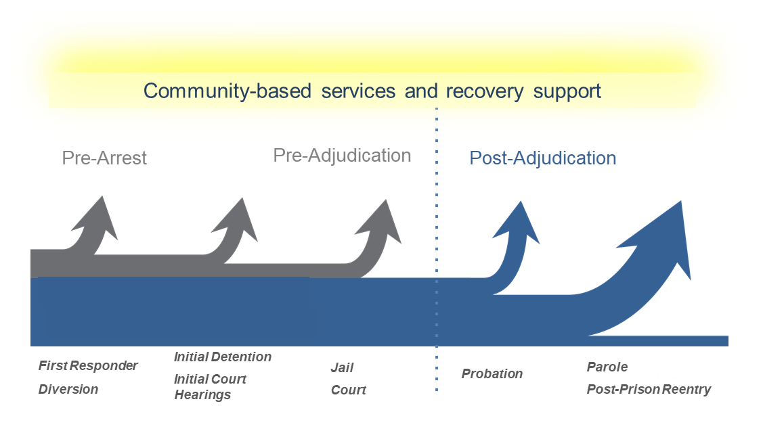
Justice System Points of Intervention The justice system can divert many people to treatment and services in the community.
© TASC’s Center for Health and Justice
Notes:
The justice system can divert many people to treatment and services in the community. The system consists of separate intervention points in multiple locations and different segments of government each of which represents an opportunity to divert people from further penetration into the justice system.
CM provides a central point of contact for resources for treatment providers, justice and community partners
Over the years we have learned that the justice system has iatrogenic effects—a term borrowed from medicine that means the cure is worse than the disease. In criminal justice, we call it “collateral consequences.”
Years of success in problem solving courts and reentry has enabled us to learn this and look “upstream” for earlier points of interventions, to diversion or deflection, to achieve our goals of increasing public safety and improving public health.
Intervening earlier, before the extreme collateral consequences have stacked up, is often also less costly than waiting to serve people until they have moved deeper into the system.

Slide 51
The 6 PATHWAYS OF DEFLECTION

Slide 52
Six Pathways of Deflection to Treatment
Self-Referral: An individual initiates contact with a first responder agency for a referral to treatment and services, without fear of arrest.
Active Outreach: A first responder intentionally identifies or seeks out an individual to refer to or engage in treatment and services.
Naloxone Plus: A first responder and program partner conduct outreach specifically to individuals who have experienced a recent overdose to engage and provide a link to treatment and services.
Notes:
Generalized: framework for the methods, learn more
As the TTA provider for FR led diversion, we’ve reviewed the national landscape on this new, innovative area of diversion. I find FR led diversion particularly interesting because these interventions have been organically driven by departments across the country who have problem solved around the opioid crisis in their jurisdictions. As a result multiple pathways to treatment have been developed. We categorized them into five primary pathways.
You will find much more info on these pathways on the COSSAP webpage.
**outreach teams including people with lived experience, similar to credible messengers

Slide 53
Six Pathways of Deflection to Treatment (Cont.)
First Responder/Officer Referral: As a preventative approach, during routine activities such as patrol or response to a service call, a first responder conducts engagement and provides treatment and service referrals.
Officer Intervention: (Law Enforcement Only) In lieu of arrest, law enforcement engages/refers to treatment and services; charges held in abeyance or citations issued – completion of treatment required.
Community Referral: In response to service call, a community-based behavioral health team (crisis workers, clinicians, peer specialists, etc.) engages individuals to help de-escalate crises, mediate low-level conflicts, or provide to treatment, services, or to a case manager.
Notes:
Generalized: framework for the methods, learn more
As the TTA provider for FR led diversion, we’ve reviewed the national landscape on this new, innovative area of diversion. I find FR led diversion particularly interesting because these interventions have been organically driven by departments across the country who have problem solved around the opioid crisis in their jurisdictions. As a result multiple pathways to treatment have been developed. We categorized them into five primary pathways.
You will find much more info on these pathways on the COSSAP webpage.
**outreach teams including people with lived experience, similar to credible messengers

Slide 54
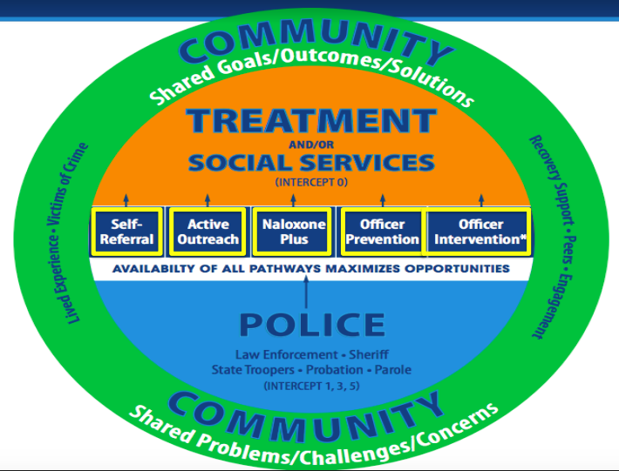
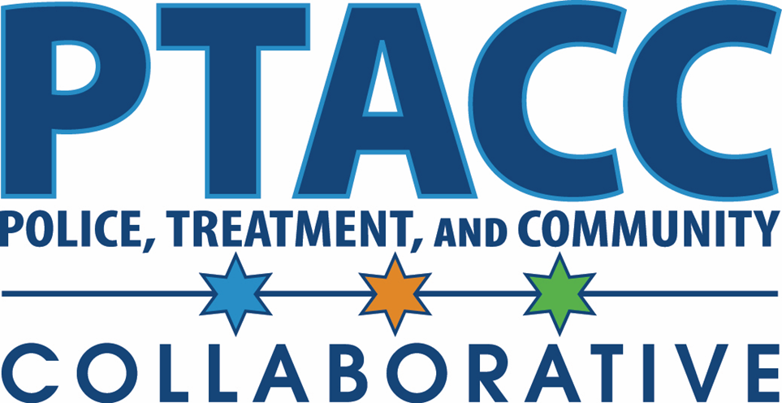
Various Types of Deflection Responders
Deflection Responders
Centered in community
Communities assemble the responders needed to respond to their unique SUD/BH issues

Slide 55
DEFLECTION: Benefits Communities – The Evidence*
Helps ease strain of opioid response on law enforcement; helps effectively address/reduce harm associated with SUD and opioid crisis
Associated with reduction in fatal overdoses and property crimes in two of six sites studied (including Lake County, IL)
Can help reduce stigma
Melissa M. Labriola, Samuel Peterson, Jirka Taylor, Danielle Sobol, Jessica Reichert, Jon Ross, Jac Charlier, and Sophia Juarez, A Multi-Site Evaluation of Law Enforcement Deflection in the United States, RAND Corporation, RR-A2491-1, 2023. National Institute of Justice Grant No. 2019-75-CX-0011

Slide 56
DEFLECTION: Benefits Communities – The Evidence*
Seen as a viable new policing approach to drug issues, alternative course of action for responding to the opioid crisis.
Contributes to positive experiences among deflection initiative partners and participants – especially in comparison to previous and/or expected encounters with the system.
Offers a promising response to public concerns about drug problems.
Melissa M. Labriola, Samuel Peterson, Jirka Taylor, Danielle Sobol, Jessica Reichert, Jon Ross, Jac Charlier, and Sophia Juarez, A Multi-Site Evaluation of Law Enforcement Deflection in the United States, RAND Corporation, RR-A2491-1, 2023. National Institute of Justice Grant No. 2019-75-CX-0011

Slide 57
DEFLECTION: Benefits Communities
Creates “low bar” easy access to treatment, housing, and services
Getting to people earlier than possible before deflection
Improved public safety (real and perceived)
Movement away from use of the justice system for BH issues
Reduced crime
Avoidance of escalation in police-resident encounters
Reduction in the “social burden” placed on law enforcement
Building police-community relations
Building (more) public health/public safety collaborations
Addressing racial disparity
“Net-narrowing” strategy
Keeping families intact – children and parents
Cost savings
Lives saved, lives restored

Slide 58
Critical Elements of Innovative First Responder Deflection Initiatives
Element 1: Partnership Building
Element 2: Community Engagement/Buy-In
Element 3: Standardize First Responder Diversion Within the Agency
Element 4: Care Coordination and Case Management
Element 5: Program Evaluation
https://www.cossapresources.org/Content/Documents/Articles/CHJ_TASC_Critical_Elements.pdf

Slide 59
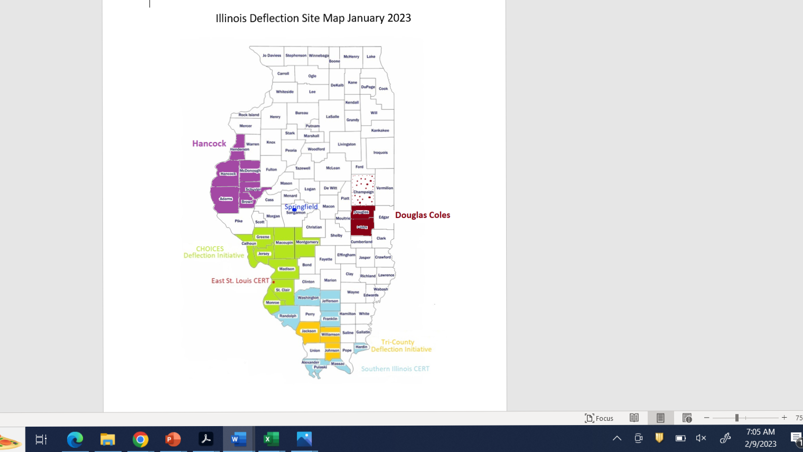
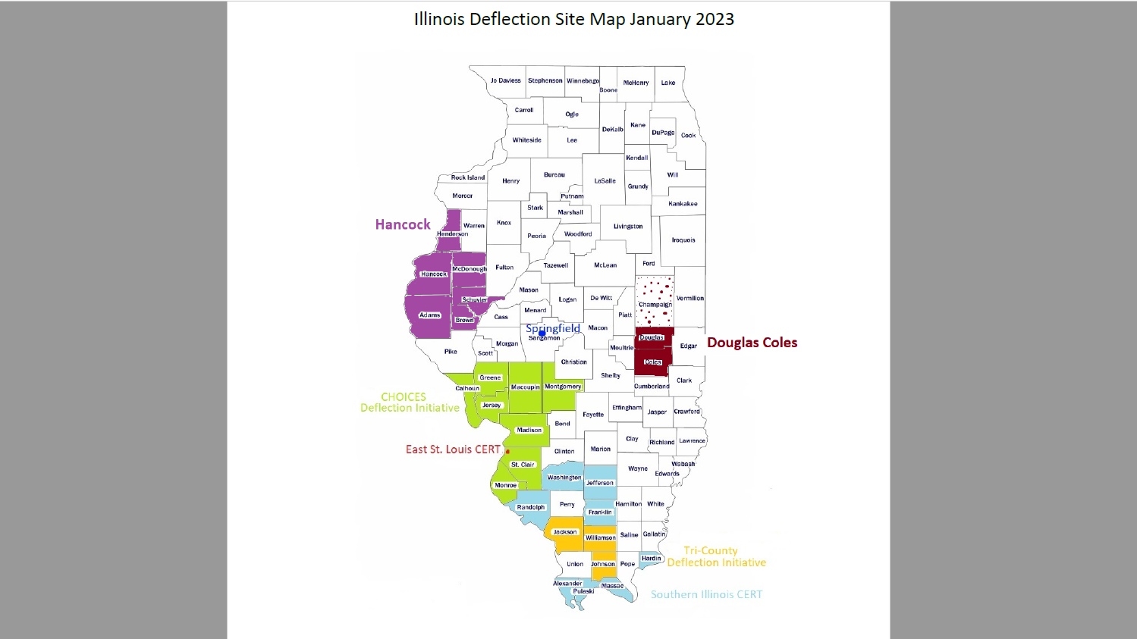
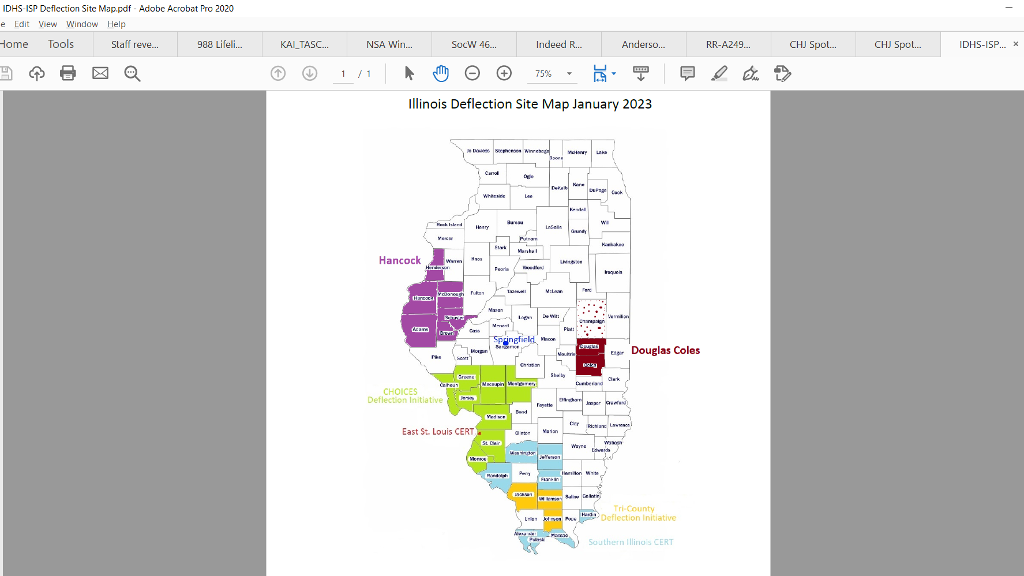

Slide 60
National Survey to Assess Law Enforcement and First Responder Deflection Programs
Key Findings and Takeaways

Slide 61
Characteristics of Lead Agency and Community Served by Agency
Key finding: Deflection programs typically have been initiated and led by law enforcement departments in response to the opioid epidemic/overdoses
Key finding: Local needs and public health/safety priorities are the primary driver for deflection initiatives
Notes:
Key finding: Deflection programs typically have been initiated and led by law enforcement departments in response to the opioid epidemic
Key finding: Local needs and public health/safety priorities are the primary driver for developing first responder programs. These localized programs create a patchwork of deflection programs across the country, with varying protocols, procedures, and measurement standards.

Slide 62
Deflection Program Types
Key finding: For all deflection pathways, large numbers of initiatives give all frontline staff deflection authority.
Key finding: The overwhelming majority of programs that perform outreach do in-person outreach to the location of the individual in the community.
Notes:
Key finding: The overwhelming number of FRD programs that participated in this survey were influenced by a specific model or “brand” of deflection. This indicates the strong influence that early-adopter FRD programs have had on other jurisdictions, especially within their regions of the country
Key finding: For all five deflection pathways, large numbers of FRD programs give all frontline staff deflection authority, suggesting that deflection is used as a broader policing practice in these agencies
Key finding: The overwhelming majority of programs that perform outreach do in-person outreach to the location of the individual in the community.

Slide 63
Deflection Program Types
Key Finding: More than half of the programs responding to this survey involve co-responders.
Key finding: More than half of FRD programs provide a personal introduction to treatment case managers.
Key Finding: Many deflection programs do not have specialized training – particularly in areas like the neuroscience of addiction, motivational interviewing, etc.
Notes:
Key Finding: Slightly more than half of the programs responding to this survey involve co-responders (predominantly peer support specialists/recovery coaches, clinical SUD treatment staff, case managers, and social workers), an important finding given the national spotlight now being focused on co-responders.
Key finding: More than half of FRD programs provide a personal introduction to treatment case managers to assist in linkage to services, helping to overcome a significant barrier to getting treatment.
Key Finding: Many programs do not have specialized training that would help staff members who conduct deflection and outreach to increase their effectiveness.

Slide 64
Deflection Program Partnerships
Key finding: Having multiple community-based service partners is a key element in the operation of successful initiatives.
Key finding: Most deflection initiatives have a dedicated program coordinator.
Key finding: More than half of respondents have agreements, often not formal, with community-based partners for services they facilitate.
Notes:
Key finding: Having multiple community-based service partners is a key element in the operation of deflection programs. These partners come from across the justice system and recovery community.
Key finding: Most FRD programs rely on a program coordinator to ensure the day-today work of the program runs smoothly and are guided by a stakeholder group that meets regularly to make important program decisions collaboratively
Key finding: More than half of respondents have agreements with their community-based partners regarding the services they will facilitate, but often these are not formalized in writing. In addition, agreements often do not clarify critical expectations regarding length of time to care, information to be exchanged, and metrics for success.

Slide 65
Treatment, Services and Recovery
Key finding: SUD treatment that includes access to medication-assisted treatment (MAT) is the primary service referred.
Key finding: Recovery support specialists play an key role in initial outreach to/ongoing engagement of individuals.
Key Finding: Funding for deflection-related treatment is approximately equally distributed between public/private sources.
Key Finding: Almost 90 percent of programs that responded to the survey are located in states that have expanded access to health care services through Medicaid via the Affordable Care Act.
Notes:
Key finding: Substance use treatment that includes access to medication-assisted treatment is the primary service referred by deflection programs.
Key finding: Recovery support specialists play an important role in initial outreach to and continued engagement of individuals in deflection programs.
Key Finding: Funding for deflection-related treatment is approximately equal between public and private sources, but regardless of the source of funding, nearly 90 percent of programs that responded to the survey are located in states that have expanded access to health care services through Medicaid via the Affordable Care Act.

Slide 66
Funding, Data, Performance Measures, and Evaluations Associated with Deflection
Key Finding: Local funding plays a significant role in both the startup and continuing operation of FRD programs.
Key finding: Data on deflection clients’ demographics are comparable to the national population but do not reflect the demographics of those currently in the justice system.
Key Finding: Only one in six participating programs has conducted a formal evaluation of program effectiveness.

Slide 67
White House Announces 2022 National Drug Control Strategy:
Principle #2 Outlines the Role of Deflection

Slide 68
White House Announces
State Model Law to Expand Programs that Deflect People with Addiction to Care

Slide 69
Free Deflection eCourse

Slide 70
For more information and to request TTA
Hope Fiori (TTA) Jon Ross, PhD
COSSAP Project Lead Director of Research and Evaluation
hfiori@tasc.org jross@tasc.org
Request TTA on the COSSAP Resources Website
https://www.cossapresources.org/Program/TTA
TASC’s Center for Health and Justice
www.centerforhealthandjustice.org
Notes:
In addition to accessing information about COSSAP on the national cossap website, I’m providing contact information for myself and our agency if you are interested.
Thank you for your time

Slide 71
Q & A
Thank you for participating in this Workshop on National and State responses to Criminal Justice and Substance Use

